Slide 1

Big data made easy with
Yousry Mohamed
Notes:
Start SQL instance & Hadoop VM

Slide 2
Agenda
Why Spark
History
Fundamentals
Sample Applications

Slide 3
Quick Questionnaire
How many people know/work on F#/Scala/Haskell ?
How many people know/work on Hadoop ?
How many people know/heard/are using Spark ?
Notes:
Give feedback for hand show

Slide 4
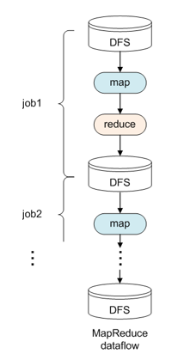
Hadoop limitations for certain apps
Why MapReduce is not enough?
Two-stage programming model → Hard/not efficient with many applications
Low-level programming API → Productivity impacted
Iterative applications → Cannot write and read to HDFS many times
Interactive analysis → Quick feedback needed not batch processing
Notes:
Go faster in why Hadoop is suitable for many applications

Slide 5
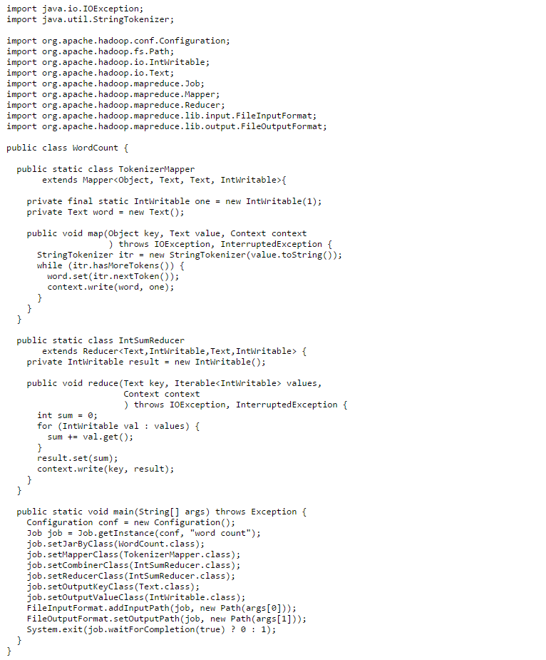
Spark word count teaser
val wordCounts = sc
.textFile("Frankenstein.txt")
.flatMap( a => a.split(" ") )
.filter( a => a.length >= 5 )
.map( a => (a,1) )
.reduceByKey( _ + _ )
.sortBy(a => a._2 , false)
.take(100)
Notes:
Give a hint that file is small but the model works well for huge data sets
Make fun of popular worlds for a speech by Obama vs a speech by Trump
After this slide ask how many lines do you expect the Hadoop equivalent

Slide 6
About Apache Spark
Initially started at UC Berkeley in 2009 by Matei Zaharia
Fast and general purpose engine for large-scale data processing
10x (on disk) - 100x (In-Memory) faster than Hadoop (much less code)
Most popular for running Iterative in-memory computations.
Provides high level APIs in : Scala / Java / Python /R
Runs on Hadoop / Mesos / Standalone.
Can access diverse data sources : HDFS, Cassandra, HBase, Azure, databases and S3.
Latest version is 2.0 which comes with many improvements
http://spark.apache.org/
Notes:
Hint that most material and docs will be 1.x for now

Slide 7
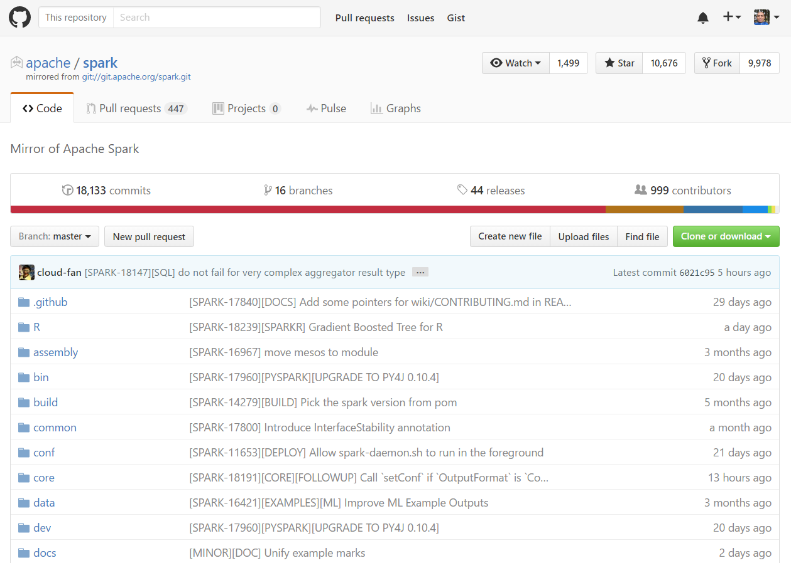
Very active community
Most active Apache project
Release cycle Every 3 months
Rich ecosystem

Slide 8
Getting started options
Local
Download binaries (JRE needed to run)
Compile from source code
Sandbox (virtual machine)
Hortonworks
Cloudera
SyncFusion
Cloud
Azure
Amazon
Notes:
do not go in details about companies

Slide 9
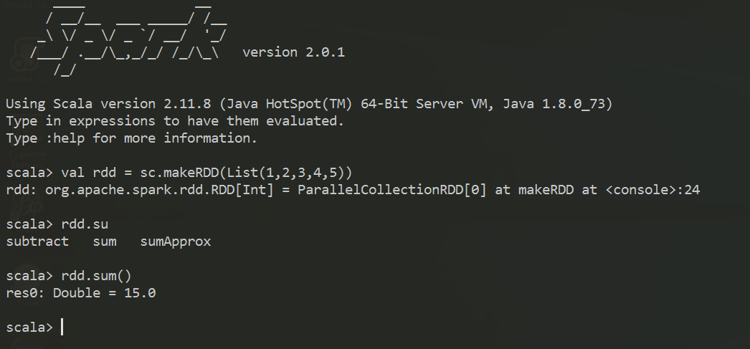
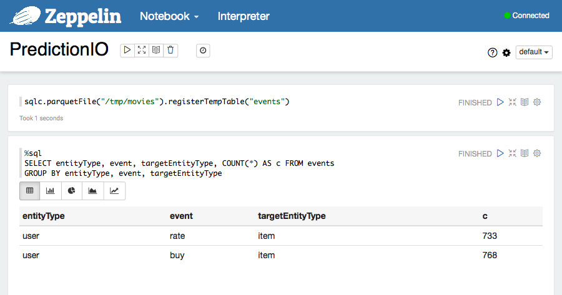
Quick Start with interactive shells
Spark Shell
Scala
Python
Notebooks
Zeppelin
Jupyter
Notes:
The barrier to entry for working with the spark API is minimal

Slide 10

Execution Flow

Slide 11
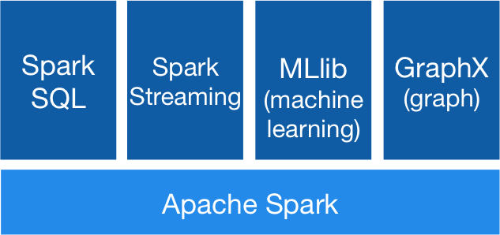
Spark Stack
Spark SQL
For SQL and unstructured data processing
MLib
Machine Learning Algorithms
GraphX
Graph Processing
Spark Streaming
Stream processing of live data streams
Notes:
do not go in details for the libraries

Slide 12
Key Concepts
Write programs in terms of operations on distributed datasets
THINK DISTRIBUTED C# LINQ
Resilient Distributed Datasets
Immutable lazy loaded partitioned collections of objects spread across a cluster, stored in RAM or on Disk
Built through parallel transformations
Automatically rebuilt on failure
Operations
Transformations (map, filter, groupBy …)
Actions (count, collect, save …)

Slide 13
Creating RDDs (our IEnumerable)
# Turn a Scala List into an RDD
Val rdd = sc.makeRDD(List.range(1,1000))
# Load text file from local FS, HDFS, or S3
sc.textFile(“file.txt”)
sc.textFile(“directory/*.txt”)
sc.textFile(“hdfs://namenode:9000/path/file”)
sc.textFile(“wasb://mycontainer@myaccount.blob.core.windows.net/files/sample.txt”)
# Use existing Hadoop InputFormat
sc.hadoopFile(keyClass, valClass, inputFmt, conf)
Notes:
Mention the good point about Spark in Azure, files are in BLOB storage

Slide 14
Basic Operations
val nums = sc.makeRDD(List(1, 2, 3, 4 , 5, 6))
# Retrieve RDD contents as a local collection
nums.collect() # => [1, 2, 3, 4, 5,6 ]
# Retrieve RDD contents as a local collection
nums.filter( a=> a %2 == 0 ).collect() # => [2, 4, 6 ]
# Return first K elements
nums.take(2) # => [1, 2]
# Count number of elements
nums.count() # => 6
# Merge elements with an associative function
nums.reduce( (x,y) => x + y) # => 21
# Write elements to a text file
nums.saveAsTextFile(“hdfs:///file.txt”)

Slide 15
Practical Example
Problem : Analyse IIS/Tomcat/Seq logs for number of requests per status code
Solution :
Load data from source
Filter/transform data
Aggregate/Summarise
Save computation result
Notes:
IIS web log example
C# console or LogLizard to parse files
There might be tools or apps to do it more easily but the point is that we have a general purpose engine suitable to process data for any problem

Slide 16
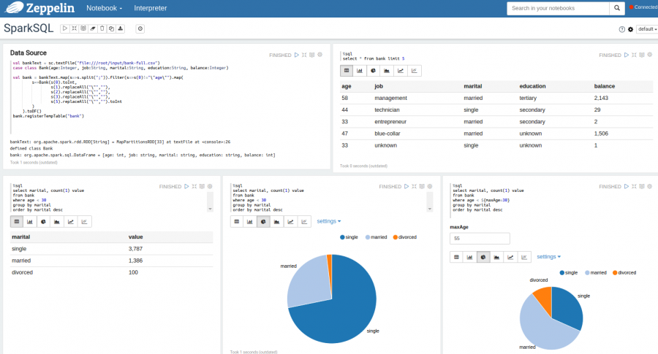
Choose right tool for the job
Shell/Notebooks for interactive analysis
Notes:
Mention why we need caching here
Caching options : memory – memory ser – memory and disk etc

Slide 17
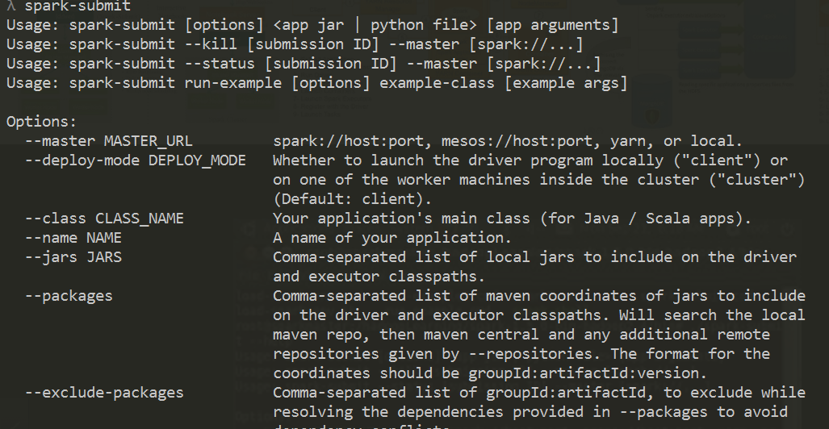
Choose right tool for the job
Spark-Submit : batch processing and streaming
Notes:
We do not have programs in Spark return in a few seconds
Sometimes we need a bit long running jobs or applications running all the time like streaming
Analyst/data scientist might prepare code for the analysis and the developer will take it compile it into a JAR and submit it to a cluster

Slide 18

Demo applications

Slide 19
Optimisation hints – Speed Justification
USA 2011 Car Crash dataset
Problem : Identify major factors impacting fatal injuries
Spark features :
Pull from database source (use SQL Profiler to monitor data source hits)
Predicate push down & selective column read (parquet/ORC …)
Partitioned read
Caching
Lazy loading
Spark SQL

Slide 20
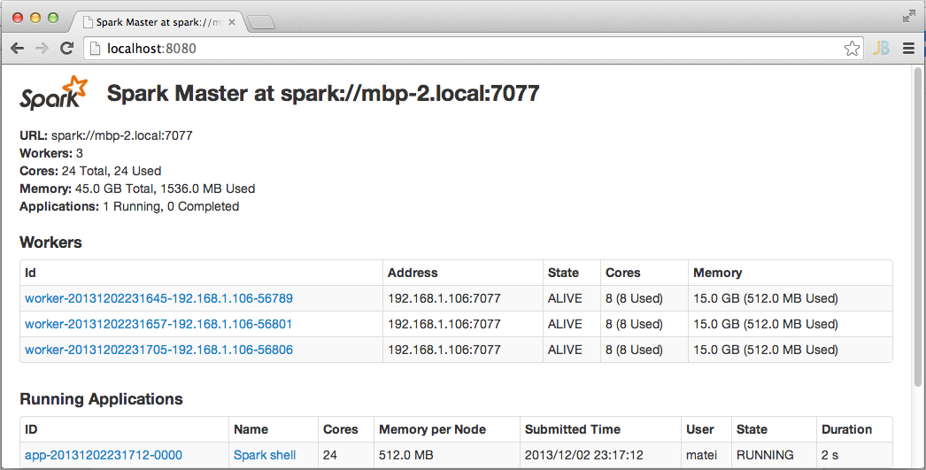
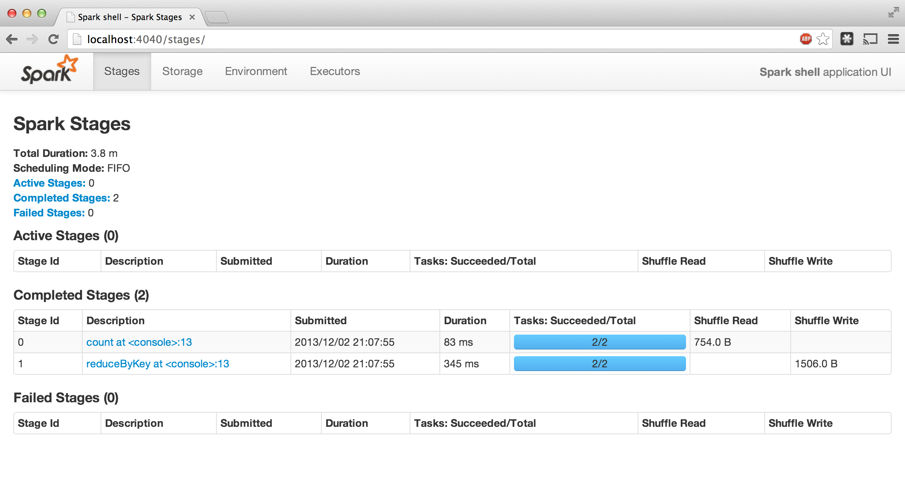
Monitoring and diagnostics
Notes:
Demo in the browser what happened with the previous example

Slide 21

Graph processing – Page Rank example
Give pages ranks (scores) based on links to them
Links from many pages ➔ high rank
Link from a high-rank page ➔ high rank

Slide 22

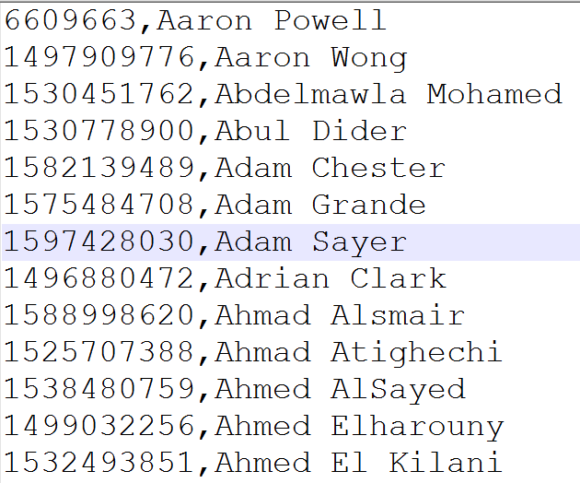
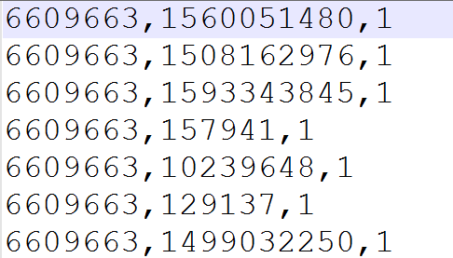
Problem Description

Slide 23
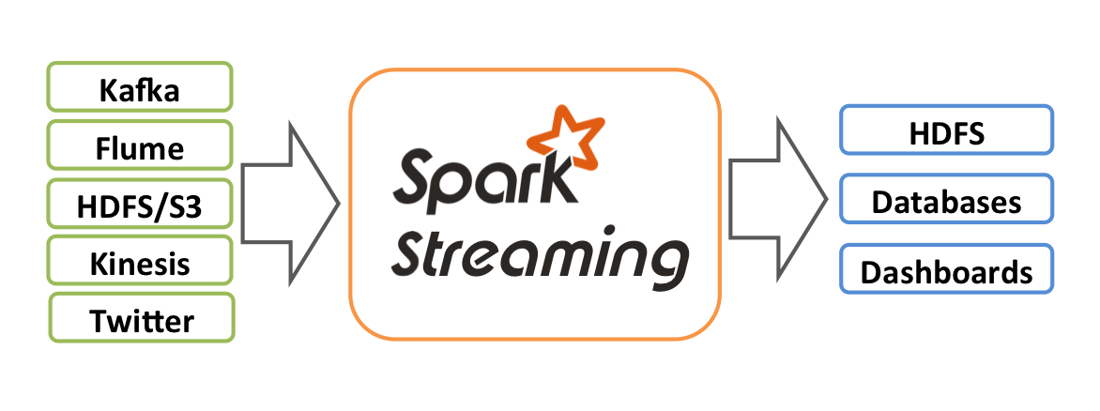
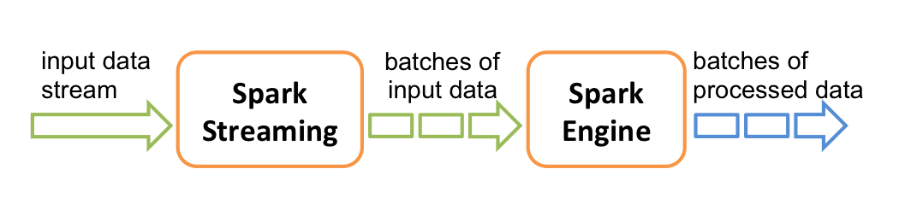
Streaming twitter statistics to Power BI
Notes:
Describe problem
Trending hashtags
Filtered Hashtags (filters can be session provided or we can try tweets with Telstra words)

Slide 24
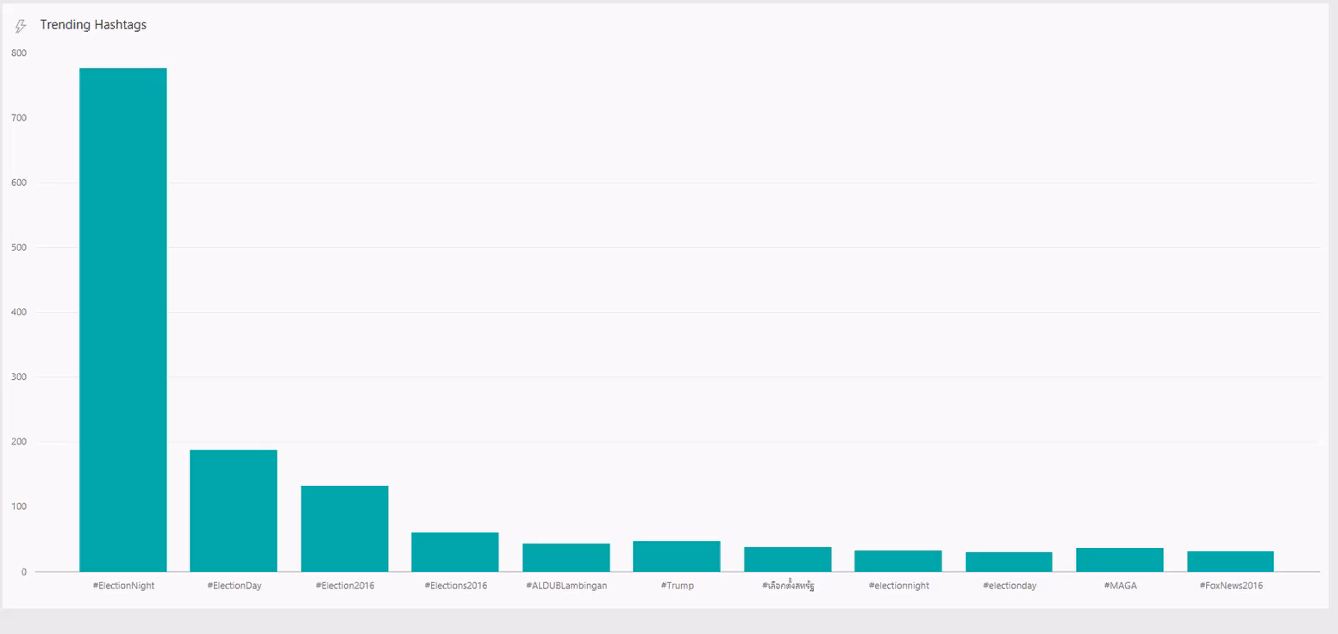

Slide 25

Movie Recommendation using ML

Slide 26
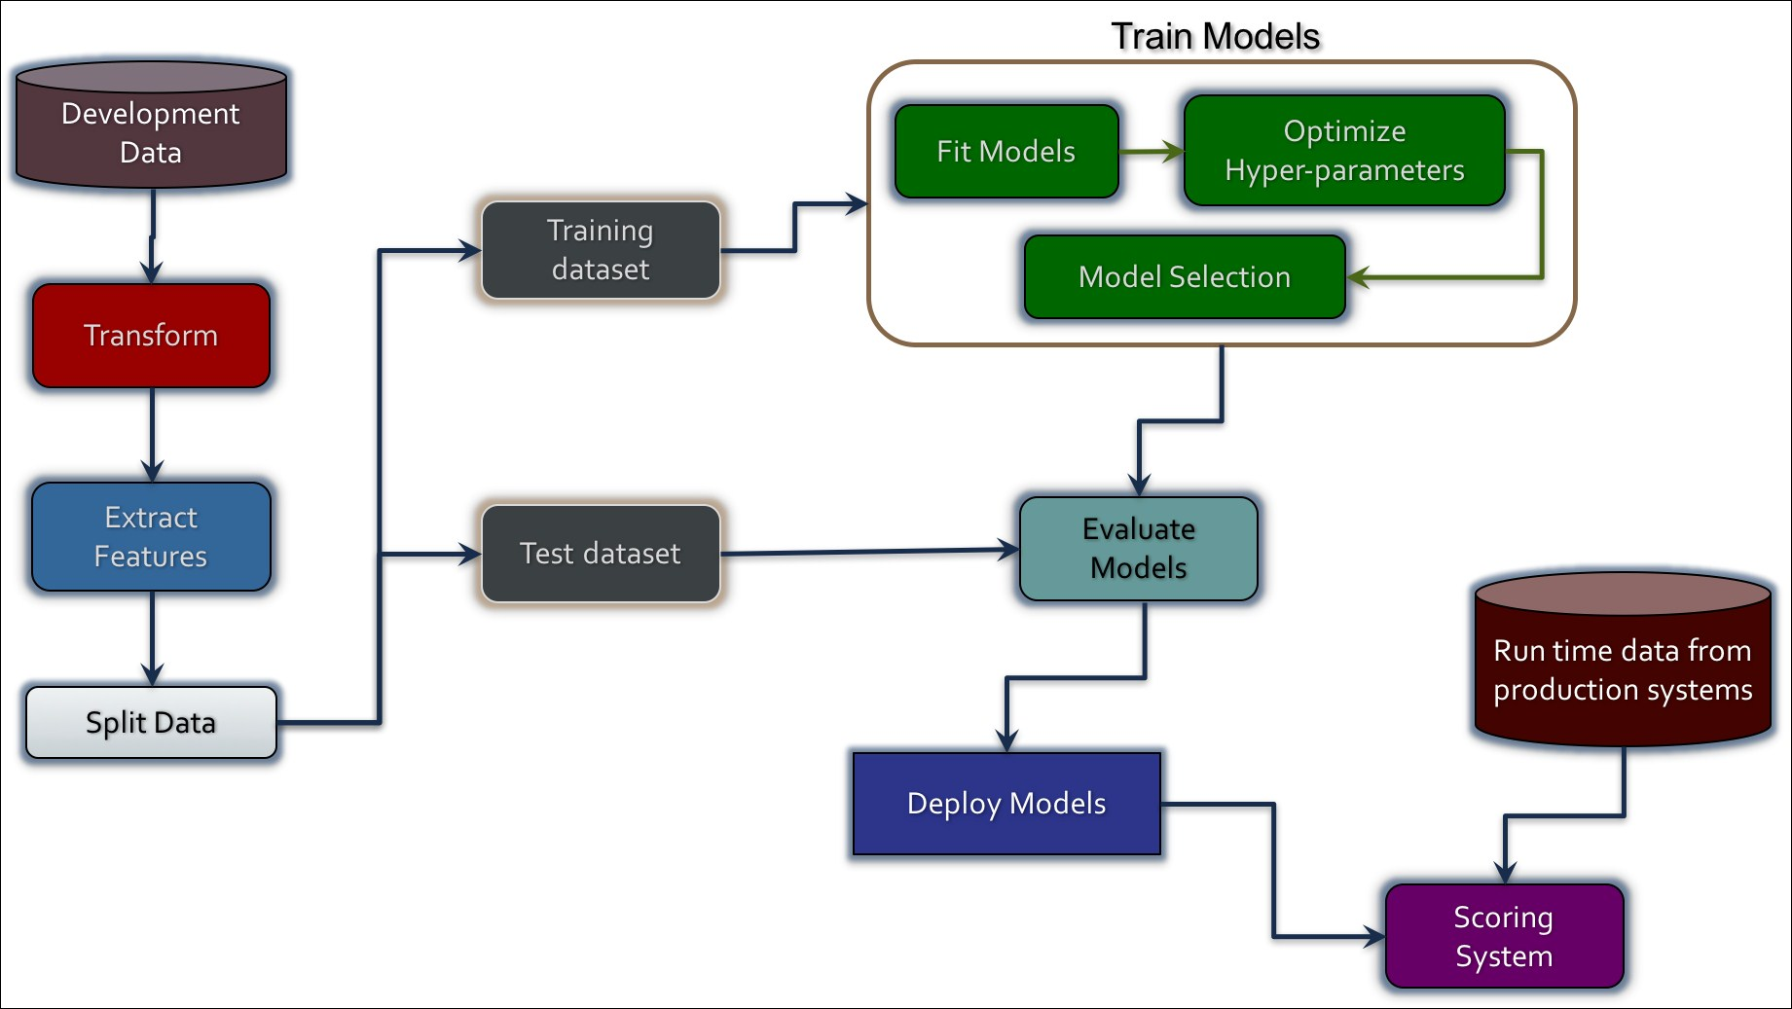
Movie Recommendation using ML
Notes:
Describe the workflow of ML
Mention saving the model

Slide 27
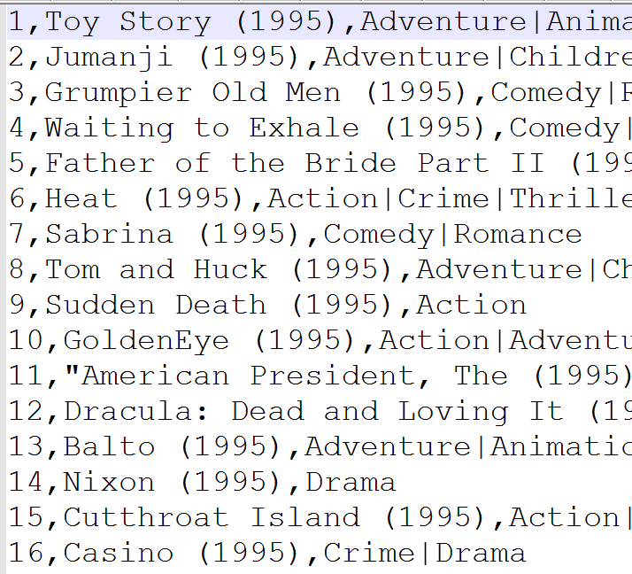

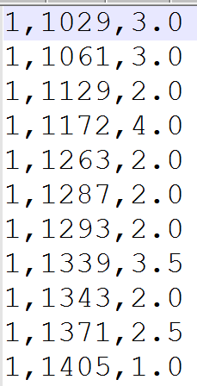
Problem Description
Notes:
Describe the workflow of ML
Mention saving the model

Slide 28
Conclusion
Spark offers a rich API to make data analytics fast: both fast to write and fast to run
Achieves 100x speedups in real applications
It’s the agile way of doing big data

Slide 29
Resources
https://spark.apache.org
databricks blog : https://databricks.com/blog
Pluralsight course : Apache Spark Fundamentals
Advanced Apache Spark Training – from databricks
http://bit.ly/1SjydTK
Git Book : Mastering Spark 2.0
Courses on Edx and Coursera
Many books

Slide 30
That’s all folks

